Slide 1
Wednesday, January 30, 2013
Agenda:
TISK, No MM
HW Check
Lesson 12-5: Linear Functions
Homework: Ch 12 HW Packet #2, §12-5 problems
TISK Problems
Write an equation in slope-intercept form for a line that passes through the points (3, 5) and (0, 1).
Find the probability of rolling a multiple of 3 then a multiple of 4 on a fair 12-sided die numbered 1-12.
Write and solve a proportion: Thirty is what percent of 40?

Slide 2
Homework Check
Tables may vary.
Tables may vary.
Tables may vary.

Slide 3
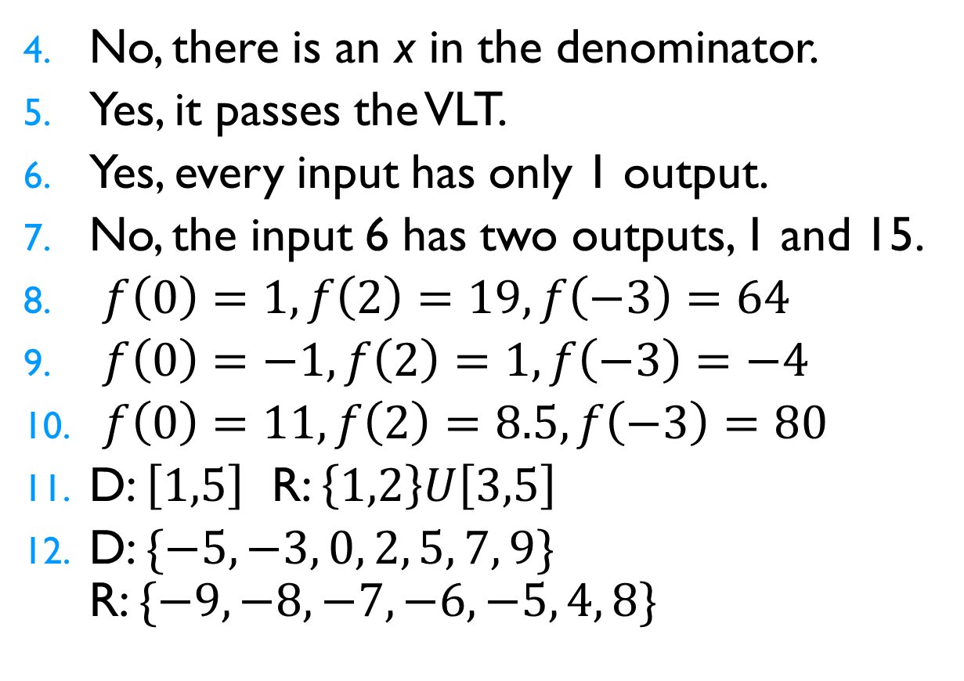
Homework Check
No, there is an x in the denominator.
Yes, it passes the VLT.
Yes, every input has only 1 output.
No, the input 6 has two outputs, 1 and 15.
$f\left(0\right)=1, f\left(2\right)=19, f\left(−3\right)=64$
$f\left(0\right)=−1, f\left(2\right)=1, f\left(−3\right)=−4$
$f\left(0\right)=11, f\left(2\right)=8.5, f\left(−3\right)=80$
D: $\left[1,5\right]$ R: $\left\{1,2\right\}U\left[3,5\right]$
D: $\{−5, −3, 0, 2, 5, 7, 9\}$ R: $\{−9, −8, −7, −6, −5, 4, 8\}$

Slide 4
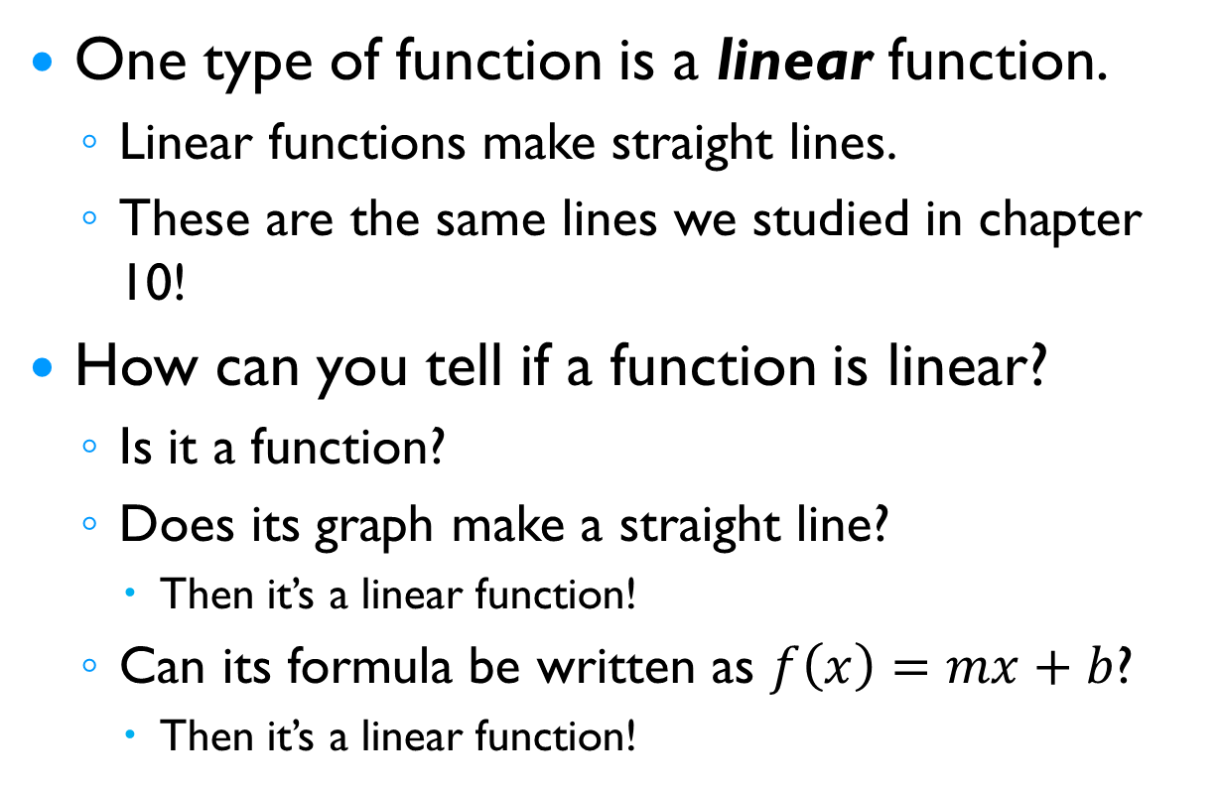
§12-5 Linear Functions
One type of function is a linear function.
Linear functions make straight lines.
These are the same lines we studied in chapter 10!
How can you tell if a function is linear?
Is it a function?
Does its graph make a straight line?
Then it’s a linear function!
Can its formula be written as $f\left(x\right)=mx+b$?
Then it’s a linear function!

Slide 5
§12-5 Linear Functions
Is the relation a linear function?
Yes, it makes a line.

Slide 6
§12-5 Linear Functions
Is the relation a linear function?
No, it doesn’t make a line.

Slide 7







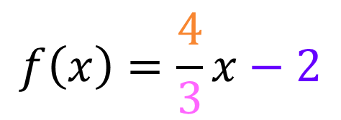
§12-5 Linear Functions
Is the relation a linear function?
Yes, it makes a straight line.
What could be the rule for that line?
$$f\left(x\right)=mx+b$$
$$f\left(x\right)=\frac{4}{3}x−2$$
$$4$$
$$m=$$
$$b=$$
$$−2$$
$$3$$

Slide 8



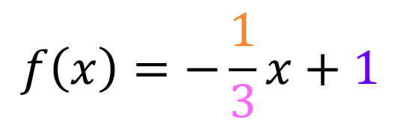
§12-5 Linear Functions
Write a rule for the function.
What could be the rule for that line?
$$f\left(x\right)=mx+b$$
$$f\left(x\right)=−\frac{1}{3}x+1$$
$$−2$$
$$m=$$
$$b=$$
$$1$$
$$6$$

Slide 9




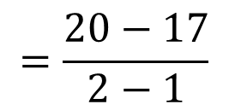




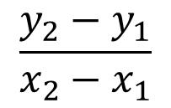








§12-5 Linear Functions
Write a rule for the function.
x | y
-2 | 8
1 | 17
2 | 20
10 | 44
These are all ordered pairs.
Then we can solve this by using any two points and point-slope form.
$$f\left(x\right)=mx+b$$
$$y−y_{1}=m(x−x_{1})$$
$$\left(1, 17\right)=\left(x_{1},y_{1}\right)$$
$$17$$
$$1$$
$$y− = (x− )$$
$$3$$
$$\left(2, 20\right)=\left(x_{2},y_{2}\right)$$
$$y−17=3x−3$$
$$+17$$
$$+17$$
$$\frac{y_{2}−y_{1}}{x_{2}−x_{1}}$$
$$=\frac{20−17}{2−1}$$
$$=\frac{3}{1}$$
$$m=$$
$$=3$$
$$y=3x+14$$
$$f(x)=3x+14$$

